Slide 1
2025 Economics Syllabus v1.0
A teachers’ perspectives on what to look at first, and prioritizing next steps

Slide 2
Summary of personal key takeaways
Glossary of cognitive verbs appears unchanged
2018 glossary is hyperlinked explicitly
“Selecting ISMG” is gone
slight merge with Analysing and Creating
Meaning the numbers, up to 25 are different now
IE 54664=25 for IA2 is now 6874=25
The word “conclusion or decision” in Evaluating is now just “Decision”
Not really important, just simpler and therefore good
Not many changes to Units 1 and 2
So a bit of breathing room to prepare for Unit 3 and 4 in 2026

Slide 3
Summary of personal key takeaways
Unit 3 is rearranged a bit
Some subject matter was swapped across Topics 1 and 2
They have different names as well
Unit 4 seems like the most substantially changed
Topic 1: Macroeconomic objectives
Topic 2: Economic Indicators and Past Budget Stances
Topic 3: Economic Management
IA3 now includes Topic 1 and Topic 2
EA includes Topic 1 and Topic 3

Slide 4
Subject matter changes
Small concepts or and terminology added or removed
Not really going to focus on “what changed” and instead focus on “what it is now”.
No real substantive changes to subject matter in Units 1 and 2, which means we have some breathing room for the bigger ammendments in Unit 3 and 4
Subject matter swapped around a bit across topics
Unit 4 is now 3 topics, with the old Topic 1 new expanded a bit

Slide 5
Double Loop Leaning
Act
Gather Data
Reflect
Design
How does this fit within our School and faculty pedagogy?
How does this align with the needs and goals of our diverse learners?
How does the current capacity and capability of our teachers impact our approach to the new syllabus?
How can the updated syllabus parameters be adhered to with honesty and integrity, while ensuring transition be as smooth as possible for all stakeholders.
Personal, obvious goal: 2024-2026 should be smoother than 2018-2020

Slide 6
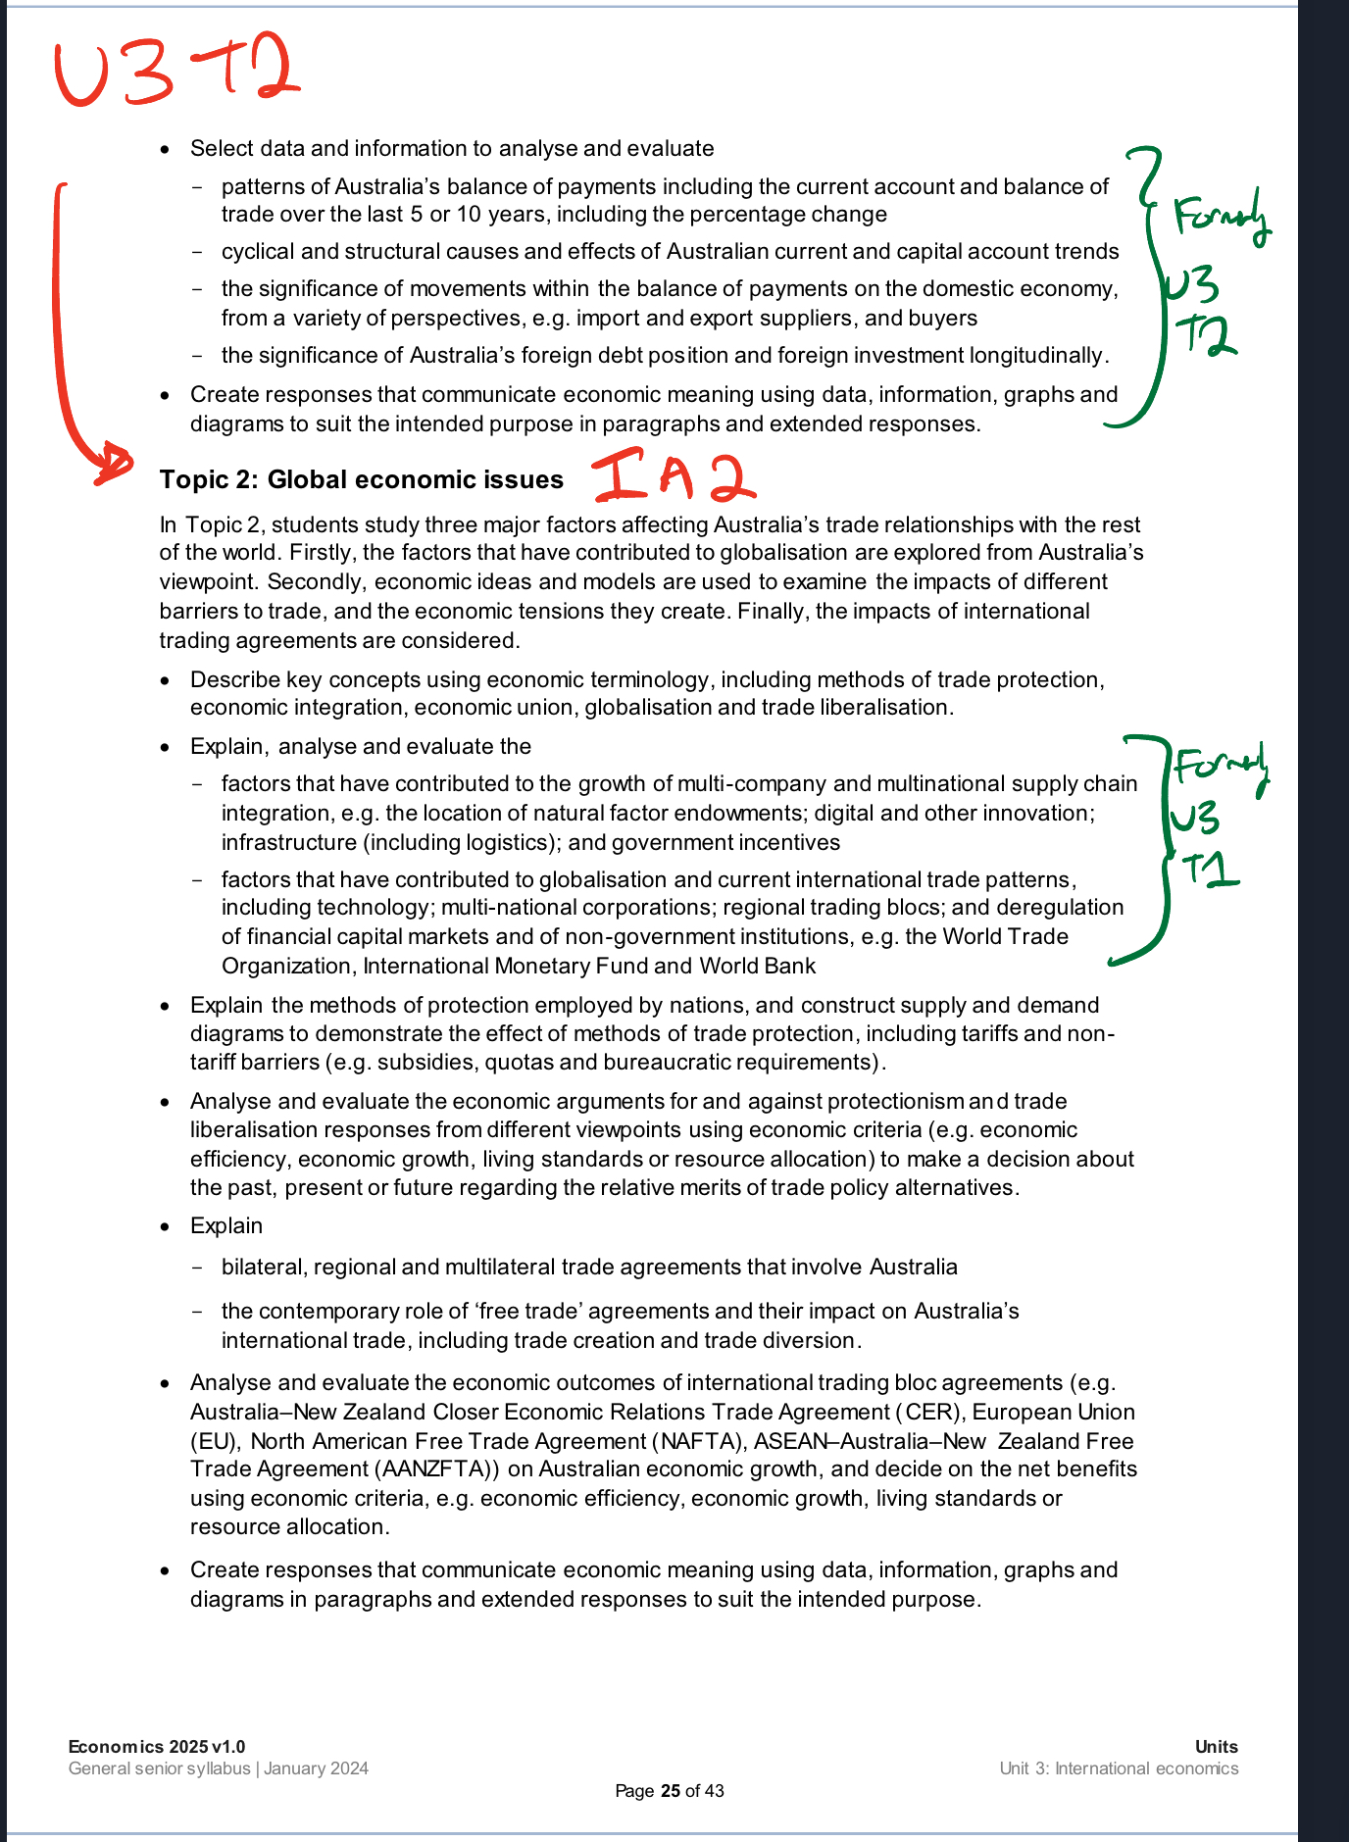
Unit 3: Some subject matter swapped around

Slide 7
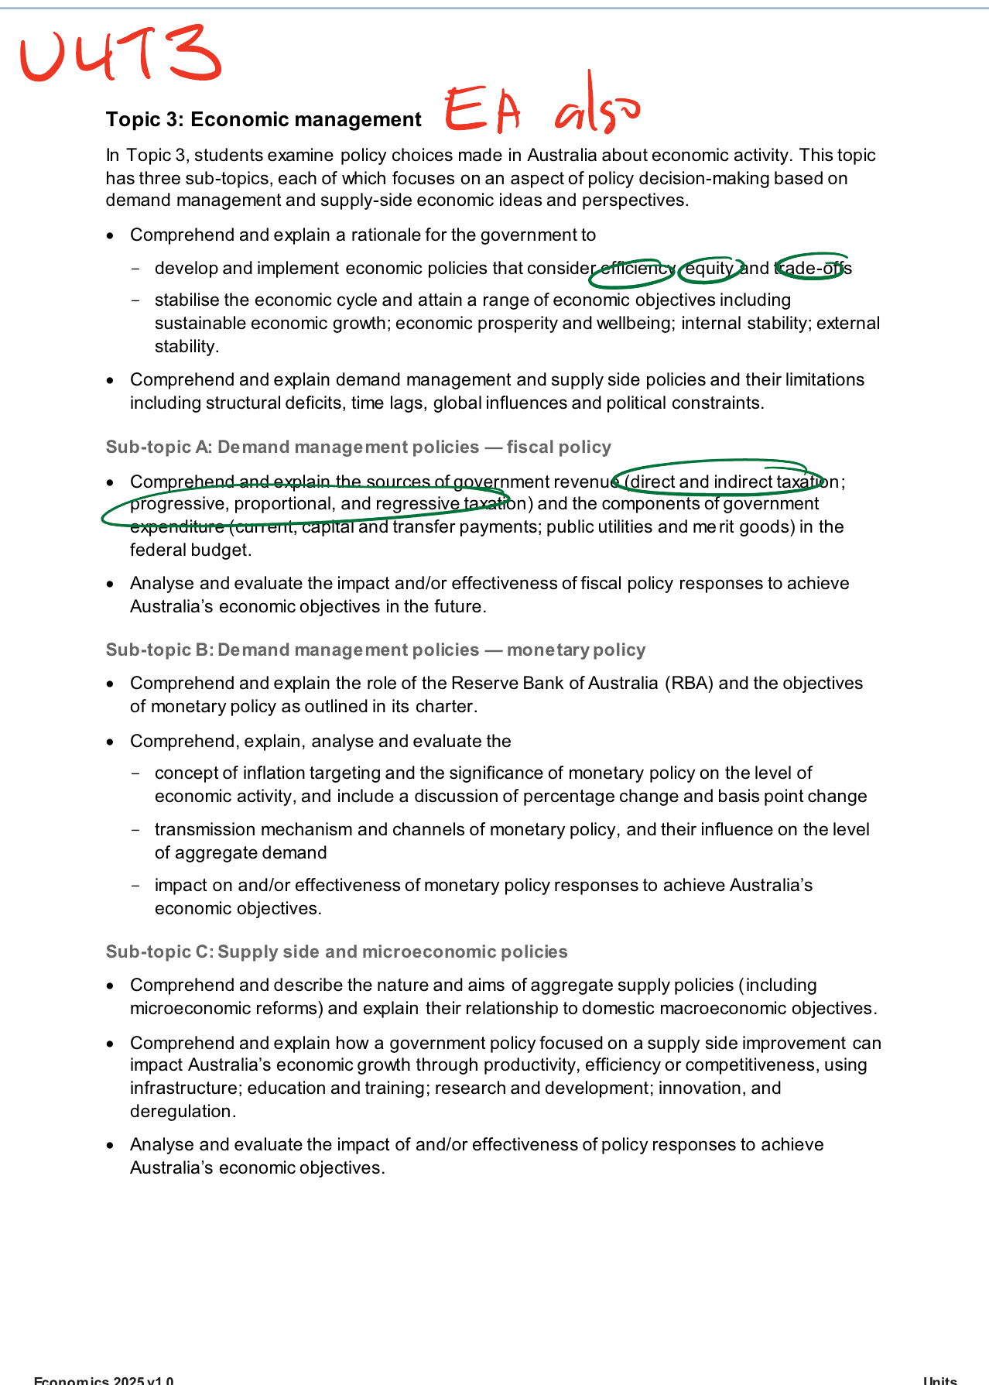
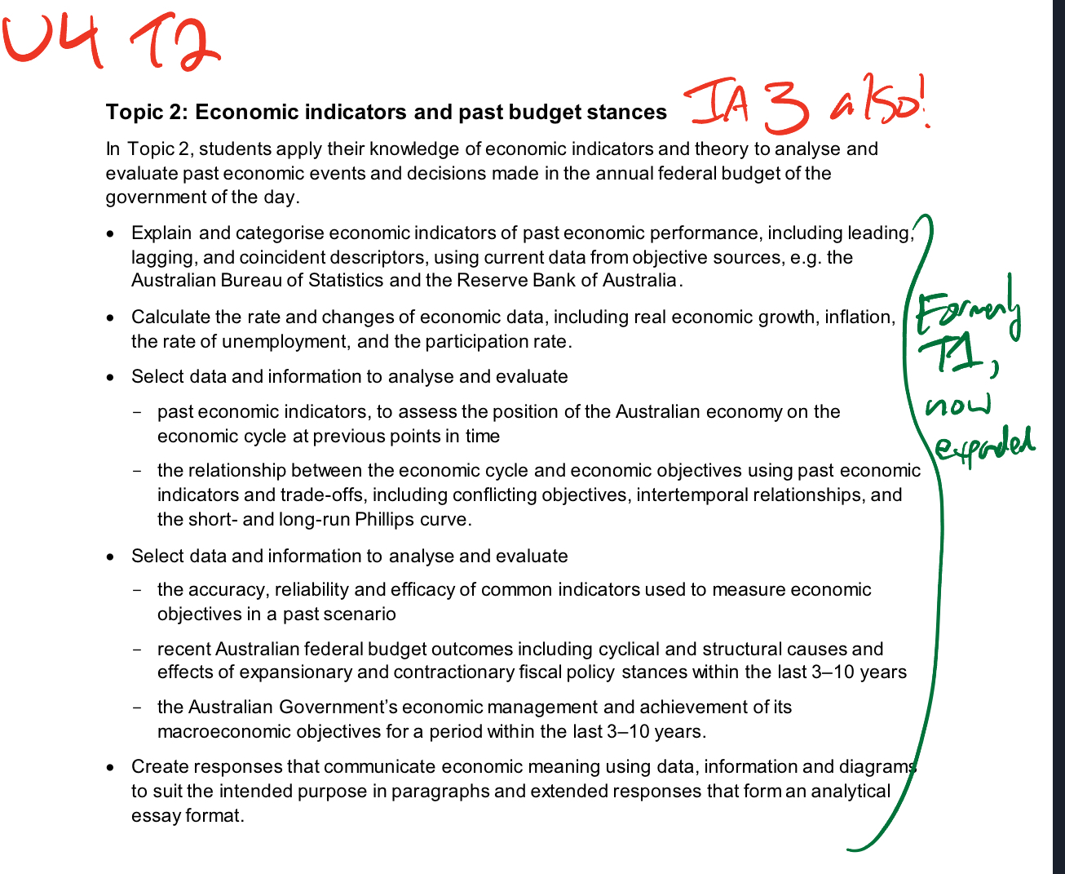
Unit 4: More substantial changes

Slide 8
IA1 Specifications

Slide 9
IA1 Evaluating

Slide 10
IA2 Specifications

Slide 11
IA2 Comprehending and Analysing

Slide 12
IA3 Evaluating and Creating

Slide 13
IA3 Specifications

Slide 14
External Specifications

Slide 15
Summary of personal takeaways
Glossary of cognitive verbs appears unchanged
2018 glossary is hyperlinked explicitly
“Selecting ISMG” is gone
slight merge with Analysing and Creating
Meaning the numbers, up to 25 are different now
IE 54664=25 for IA2 is now 6874=25
The word “conclusion or decision” in Evaluating is now just “Decision”
Not really important, just simpler and therefore good
Not many changes to Units 1 and 2
So a bit of breathing room to prepare for Unit 3 and 4 in 2026
Unit 3 is rearranged a bit
Some subject matter was swapped across Topics 1 and 2
They have different names as well
Unit 4 seems like the most substantially changed
Topic 1: Macroeconomic objectives
Topic 2: Economic Indicators and Past Budget Stances
Topic 3: Economic Management
IA3 now includes Topic 1 and Topic 2
EA includes Topic 1 and Topic 3
Unit 3 is rearranged a bit
Some subject matter was swapped across Topics 1 and 2
They have different names as well
Unit 4 seems like the most substantially changed
Topic 1: Macroeconomic objectives
Topic 2: Economic Indicators and Past Budget Stances
Topic 3: Economic Management
IA3 now includes Topic 1 and Topic 2
EA includes Topic 1 and Topic 3

Slide 16
Possible next steps…
New ISMG into 2025 Unit 1 and Unit 2
Possible jump-ahead with formative tasks to test new ISMGs with students and teachers.
With Unit 3 and 4 (2026 - Make folder right now)
Cross-checking SR questions in IA1 to ensure they still match. Change ones that don’t. IE, can put current account balance stuff in IA1 now
Cross-check IA2 research report for new ideas if inclined to change topic/task, IE Growth in MNCs can go into research report now…
Cross-check IA3 Essay for new ideas if inclined to change topic/task
“past budget stances - Topic 2, historic placement on economic cycle”
Same cross-checks for Unit 1 and 2, but at this stage, what seems to stand out, are just the new ISMGs and the changes to Unit 3 and 4.

Slide 17
Thank you! (and here's a survey)

